Slide 1

Regression Line: Equation(s)
$$Y=a+bX+e$$
$$\hat{Y}=a+bX$$
$$Y=\hat{Y}+e$$

Slide 2

Residuals (e)
$$e=Y−\hat{Y}$$

Slide 3
OLS Estimation: Slope (b) & Intercept (a)
Using calculus, we obtain
$$b=\frac{\sum{\left[(X−M_{X})(Y−M_{Y})\right]}}{\sum{{(X−M_{X})}^{2}}}=\frac{{SS}_{XY}}{{SS}_{X}}$$
$$a=M_{Y}−bM_{X}$$

Slide 4

OLS Estimation: Slope (b)
$$b=r\left(\frac{s_{Y}}{s_{X}}\right)$$

Slide 5

The Standardized Model
$${\hat{z}}_{Y}=βz_{X}$$

Slide 6
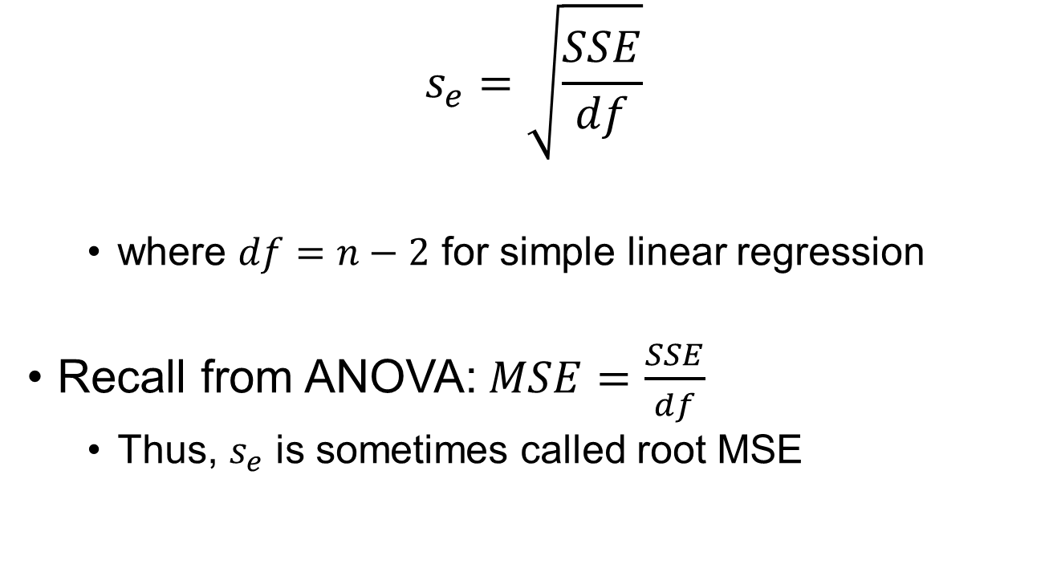
Standard Error of the Estimate
$$s_{e}=\sqrt{\frac{SSE}{df}}$$
where $df=n−2$ for simple linear regression
Recall from ANOVA:$MSE=\frac{SSE}{df}$
Thus, $s_{e}$ is sometimes called root MSE

Slide 7

Coefficient of Determination
Coefficient of determination: $r^{2}$ or $R^{2}$
Proportion of variance in $Y$ that is accounted for by $X$
Y
X
R^2

Slide 8
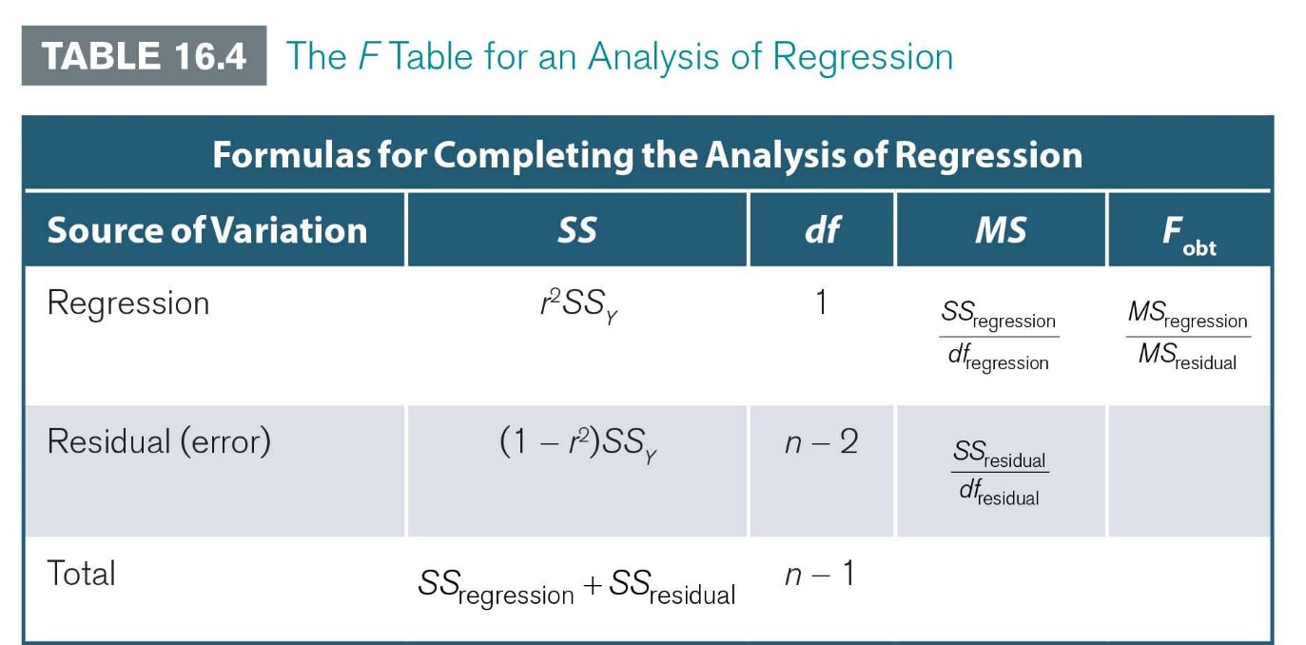
Hypothesis Test for $ρ^{2}$
F-statistic:

Slide 9
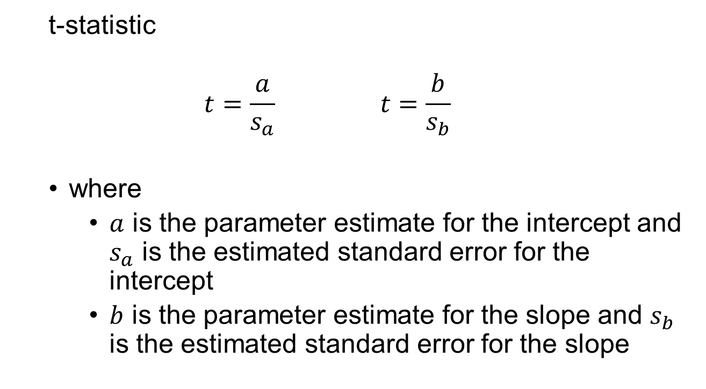
Hypothesis Test for $α^{∗}$ and $β^{∗}$
t-statistic
$$t=\frac{a}{s_{a}} t=\frac{b}{s_{b}}$$
where
$a$ is the parameter estimate for the intercept and $s_{a}$ is the estimated standard error for the intercept
$b$ is the parameter estimate for the slope and $s_{b}$ is the estimated standard error for the slope

Slide 10

Confidence Intervals for Intercept (a) & Slope (b)
$$a±t_{cv}\left(s_{a}\right)$$
$$b±t_{cv}\left(s_{b}\right)$$
If 0 is contained in the CI, then fail to reject the null hypothesis

Slide 11

Hypothesis Testing: Relationship between F- & t-stat
$$F=t^{2}$$
*For SLR only

